Slide 1
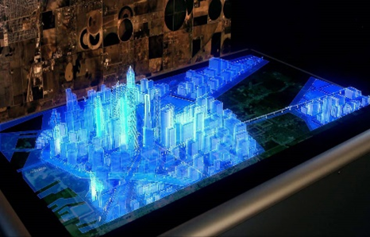
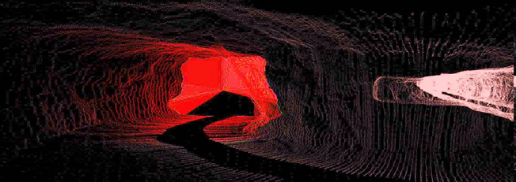
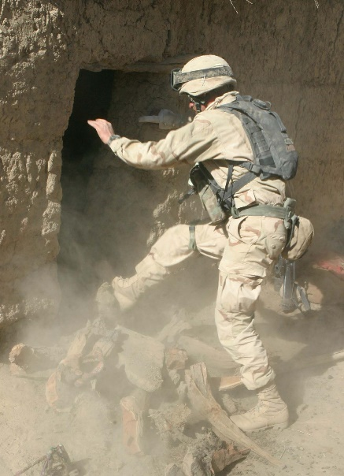
S&T Main Focus Areas
Tactically Relevant Situational Awareness and Understanding
Next Generation Identification and Characterization - comprehensive and verifiable location of targets across various sensor systems
Applicable in all environments – not just airborne assets in uncontested environments
Includes means to turn information into decision quality data – Artificial Intelligence (AI)/Machine Learning (ML)
Includes human-machine interface to make the data accessible and usable to all SOF echelons – operator through Tactical Operations Center (TOC) Commander
Communication and Navigation in all Environments
Global Positioning System (GPS) Denied – regardless of cause
Hostile, Contested, and Crowded Electromagnetic Spectrum
Low Signature
Tailored Lethality
Counter-materiel & Counter-personnel
Incorporates scalability and reversibility
Biotechnologies
Understand and counter adversary Weapons of Mass Destruction (WMD)/terror/effect
Explore means to optimize SOF warfighter capability/performance throughout their career

